Slide 1


Dough on the Roll
Jacob Schultz, Jace Brockopp, Thomas Christenson, Ryan Kilmer

Slide 2
Gameplay
Move from left side of the level to the far right side in order to jump into the oven
Use objects around the level to solve small puzzles
Using a candy cane in order to pole vault over a gap
Optional pickups around the level for bonus points
Chocolate chips
Physics based gameplay
Using the physical properties of various objects to progress
Gum is sticky so using gum to stick to floating objects

Slide 3

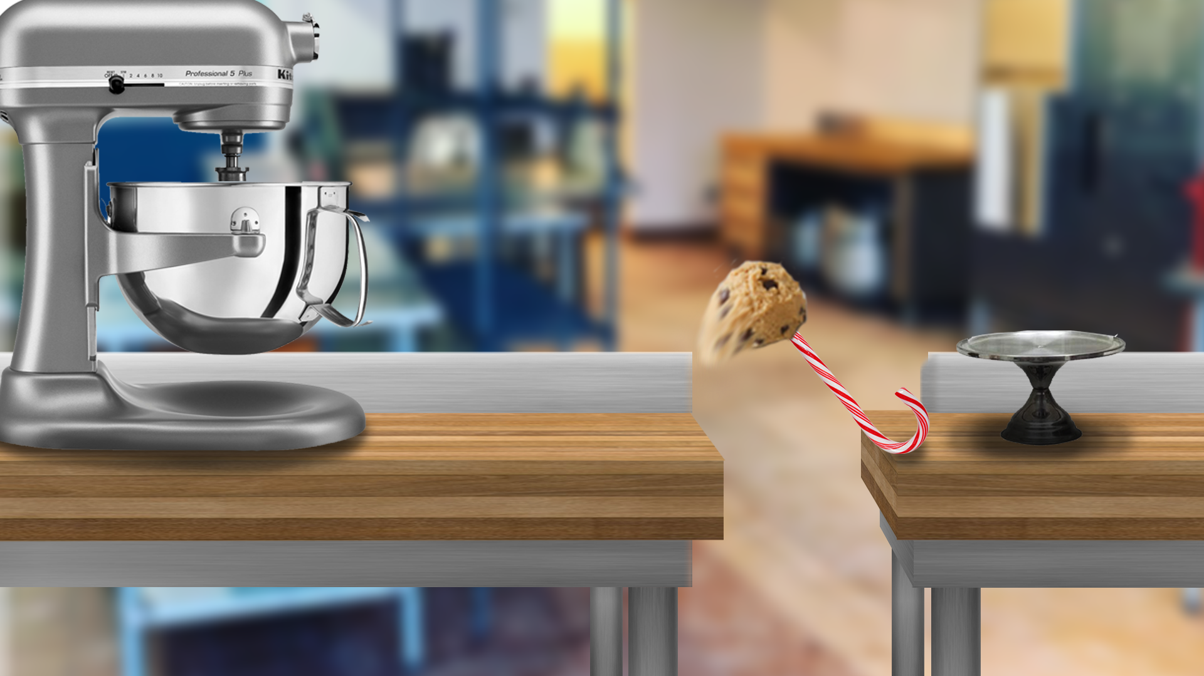
Concept Art

